Slide 1


Slide 2
Golden Key International Honour Society
New Member Recogniton Event

Slide 3
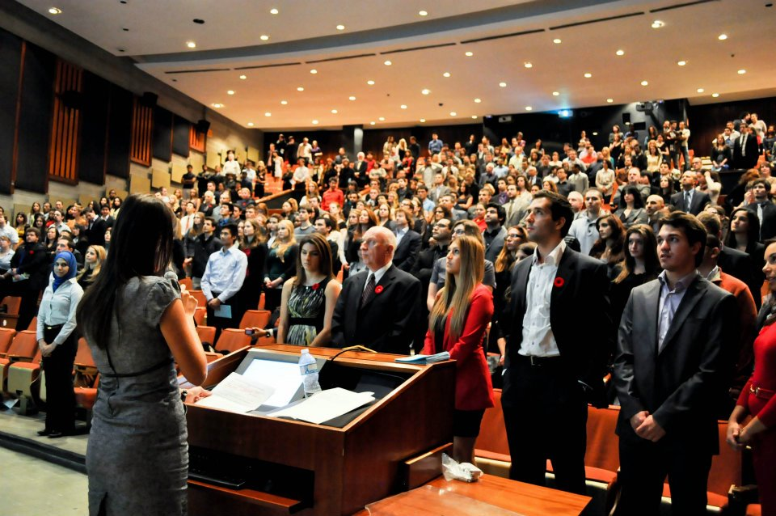
Concordia University

Slide 4
What is a New Member Recognition event?
This event welcomes members and typically the chapter’s largest event for the year.
Members are individually recognized
Honourary members are inducted
Other chapter activities and events are presented
Sometimes chapter scholarship winner are recognized
The chapter exec team is introduced and often the chapter advisor is also introduced to the members
This event is typically held in-person but virtual versions are held if an in-person event is not possible.

Slide 5
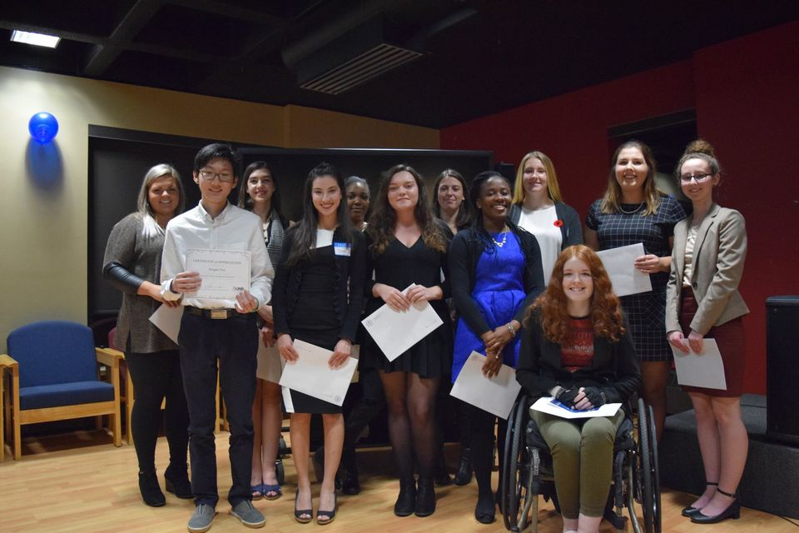
University of New Brunswick, Saint John

Slide 6
Who is invited?
Who is invited will vary by chapter and will mainly depend on the venue space and the chapter budget.
Larger chapters will typically invite only the new members (those that have joined that academic year) and sometimes they allow the members to bring guests (usually friends and family). If you click the New Members button next to the search on the member email list, that will filter for just those that have joined in the last six months.
Smaller chapters or those with a large venue space often invite all current Golden Key student members. This is a great way to bring together all the student members and even if a student joined in a past academic year, they are again invited to attend this event. Friends and family are often also welcome. That will typically depend again on the venue space and chapter budget if paying for food.
Honourary members are invited and typically speak at the event.

Slide 7
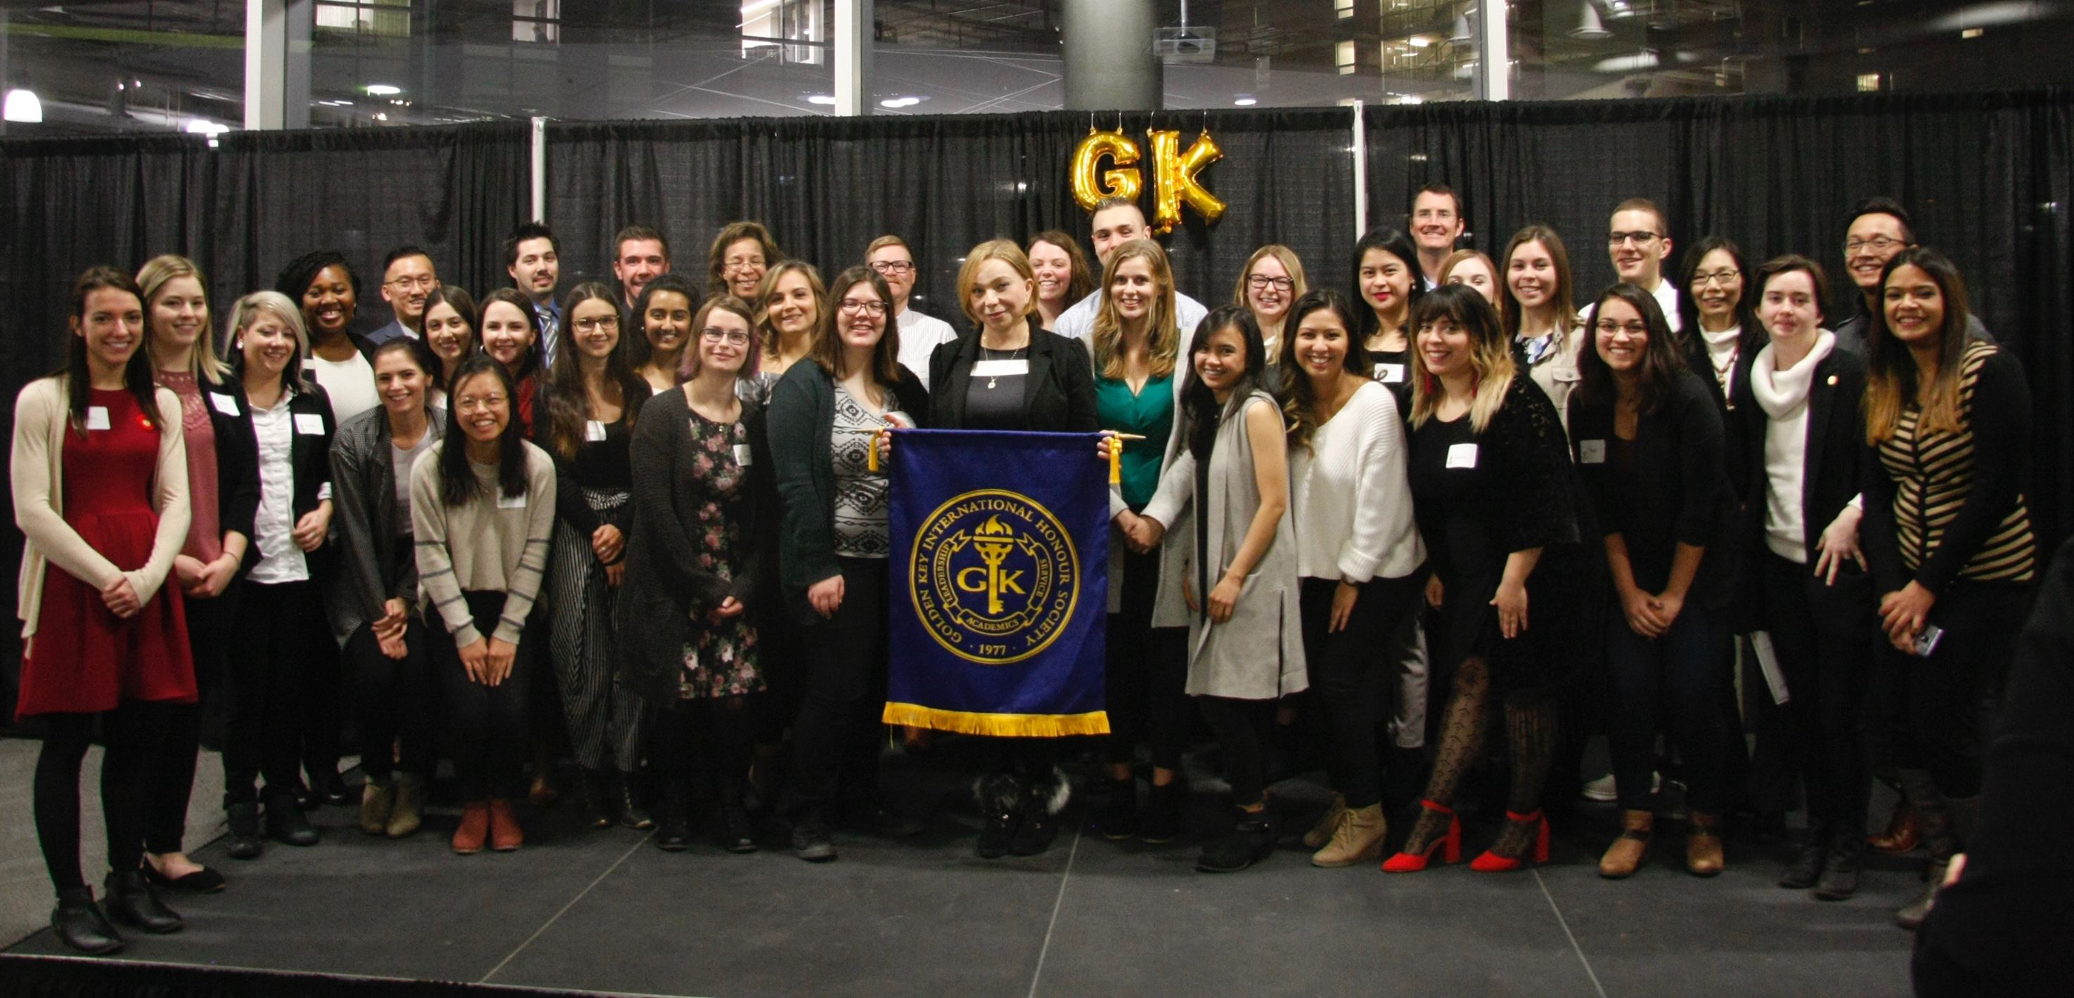
MacEwan University

Slide 8
Honourary Members
The chapter can induct up to five honourary members each year. The chapter will need to induct at least three to get the maximum points in the chapter standards.
They typically are part of the event program and speak at the event. The honourary members typically speak for 3 to 5 minutes each and share a bit about their life experiences, advice, encouragement, etc.
Honourary members are given honourary member certificates which are sent to the chapter from GK headquarters.
When you have selected the honourary members, please fill out an honourary member profile form for each individual. You can find the link at www.goldenkey.org/canadaforms

Slide 9
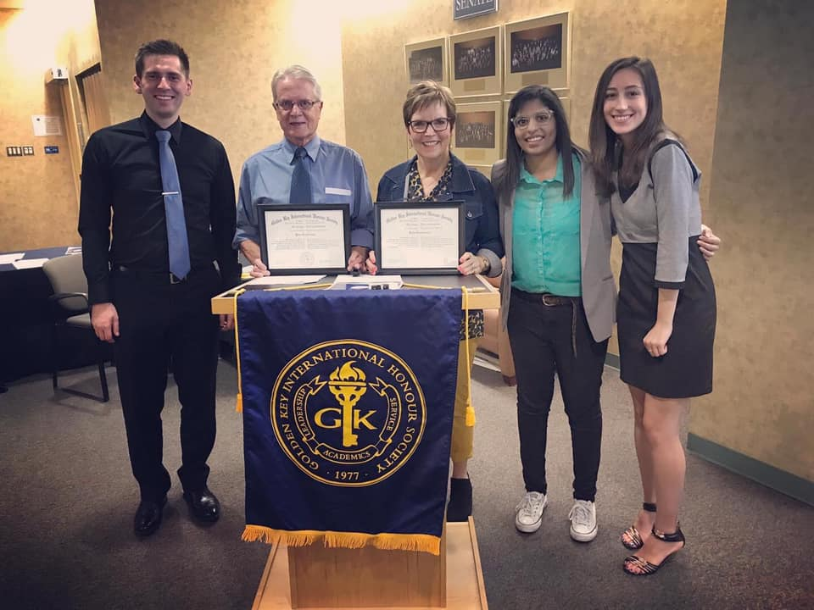
University of Lethbridge

Slide 10
Sending out invitations
It is the chapter exec team’s responsibility to invite the members to the event. Typically an email will be sent out letting the members know the details.
The chapter should have some form of registration for the members to complete so that you can gather the student names. You should ask for the first and last name on the registration form and if people are allowed to invite guests you can let them know how many they can invite and have them note the number of guests on the registration form. You may want to note an RSVP date so you have the count.
The invitations are typically sent out about 3 or 4 weeks before the event and a reminder invitation is sent 1 or 2 weeks before the event.

Slide 11
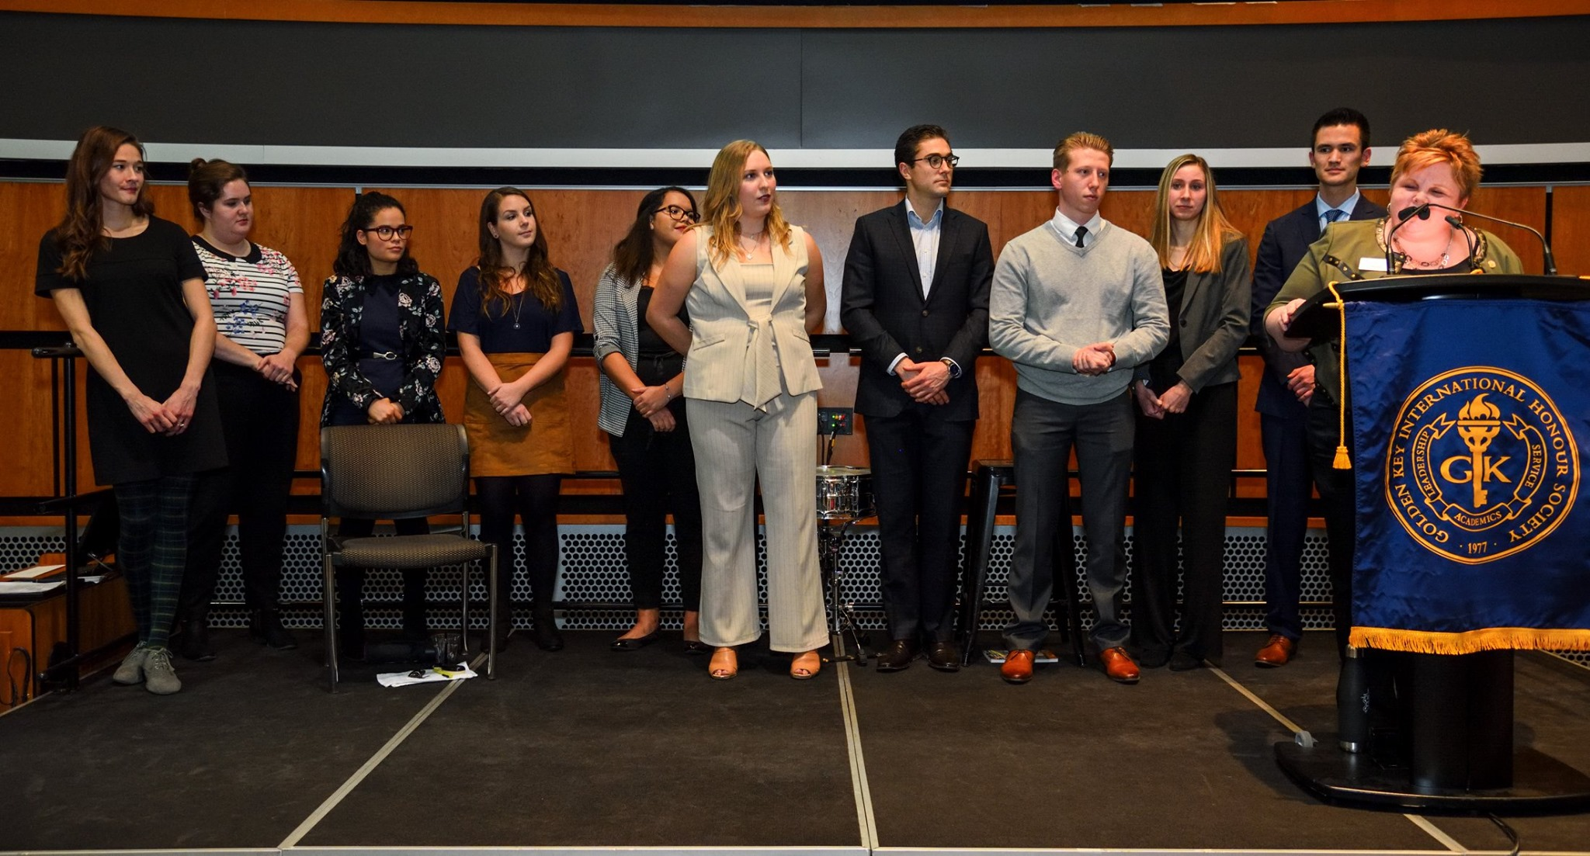
Mount Royal University

Slide 12
Timing
The invitations to the students go out in late August and September. We look to have at least 6 weeks between when the invitations arrive and when a chapter hosts their NMRE.
Most chapters will host their event sometime in November or early December. The first week of November is the earliest you host this event. Some chapters host the event in January or February which is fine too. It can be good to hold it in November or December to get the new members more involved with the chapter earlier in the academic year.

Slide 13
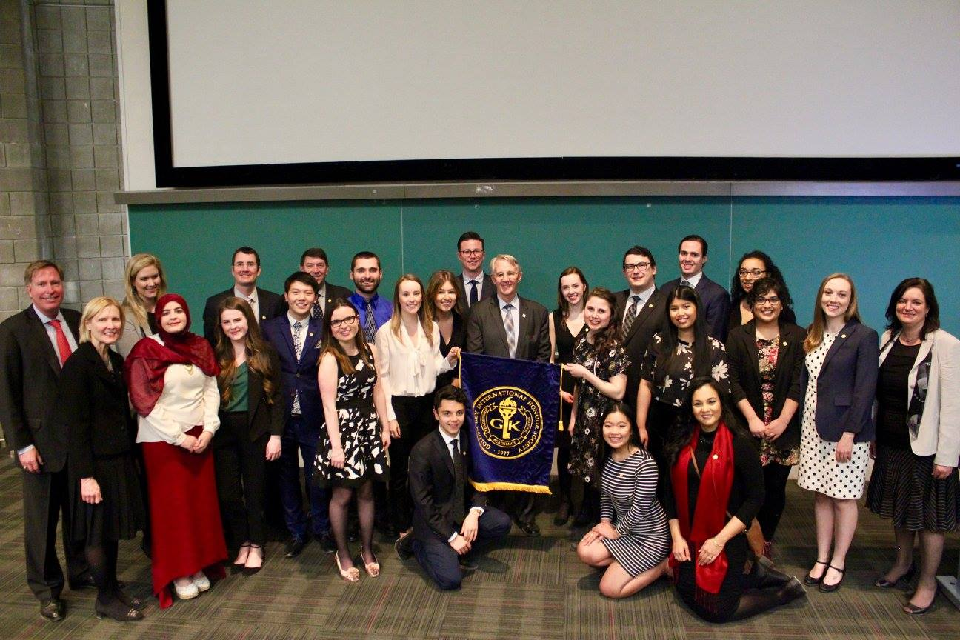
Carleton University

Slide 14
Food?
Location?
The NMREs often take place in large classrooms or auditoriums on campus. Sometimes the advisor is a good resource to help book the space. On rare occasion, they have been held off-campus at other venues like a restaurant but that is quite rare. Typically, using a space at the university is both convenient and cost effective. Often AV is needed so having a space with a projector and screen or large TV is useful. Most events also have a mic for the speakers and sometimes a podium. The AV needs will depend on the size of the space and the program details. If the GKHQ rep attends, they will usually require a screen of some sort for their presentation.
Look to book the location as soon as possible.
When you have booked a space, please let your headquarters contact know.
Some chapters have food for the members either before or after the event. Often this is finger food or sandwiches. Some universities will have you use their food services in on campus.
Food is not needed and some chapter do not have food.

Slide 15
Script
There is a standard NMRE script for the chapter to use. You can find it at www.goldenkey.org/canadaforms
The script is a blueprint of a typical event program. You can edit and adjust the script as you see fit. Feel free to edit the text, remove sections, add new sections, etc.
Each section is typically covered by a different exec member. There is also a part for the advisor to read out and introduce themselves if they will be at the event.
Personalize the text with chapter information like introducing the exec members, welcoming your honourary members, and letting the members know about upcoming chapter activities.

